Slide 1
A Single Backlit Image Enhancement for Improvement of visibility of Dark Part
Ifrah Asif Hasan (19EE38028)
Notes:
Good Morning I am Ifrah Asif Hasan performing an implementation of A single Backlit Image Enhancement for for improvement of visibility of dark part .

Slide 2
Introduction
We have proposed a simple and fast method for improvement of visibility of the dark part of an image .
We compare the Naturalness Image Quality Evaluator score and Lightness order error to compare it to other methods .
We propose this method as other methods do not have good enhancement or have high chance of producing artifacts .
Notes:
The motive behind proposing this method is that this is a fast and simple method of image enhancement where other methods have high chance of producing artifacts or give relatively poor enhancement . We compare our method to other methods using NIQE score and LOE .

Slide 3
Methodology
We can divide the process into 3 steps
Gamma correction and Histogram equalization
Alpha Blending
Artifact Suppression using a weight map using guided filter.
Using a gamma value of 2 and alpha value of 0.2, we blend the image and then use a guided filter to filter the weight map with guide as the original image to suppress the artifacts .
Notes:
We can broadly divide the entire process into 3 parts , Gamma correction and Histogram Equalization , Alpha Blending and Artifact Suppression .
Using a value of gamma as 2 we use improved images as basis for alpha blending with 0.2 parts of histogram equalized image .
Next we generate a weight map ( binary image) using Otsu’s method by maximizing class variance .
Now we generate a weight map using guided filter with guide as original image .Using the filtered weight map we again blend the original and alpha blended image to get the final image .

Slide 4
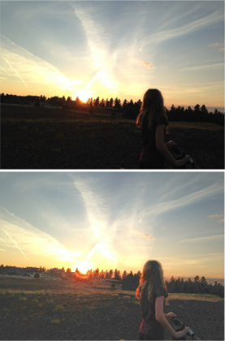
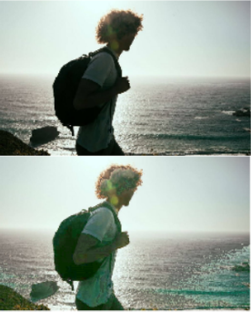
Results:
Image | Image 1 | Image 2l | Image 3
NIQE Score | 2.47 | 3.8 | 2.57
LOE | 76 | 378 | 104
Notes:
We find the Naturalness Image quality evaluation score and lightness order error of the images and compare it to other methods which is provided in the report .

